Slide 1

FAKULTI BAHASA DAN LINGUISTIK
GBT 0002 : CRITICAL THINKING AND PROBLEM SOLVING SKILLS

Slide 2
WEEK 1
INTRODUCTION

Slide 3
Assessments:
Assessment 1 (Week 7) (30%)
Assessment 2 (Week 12 & 13) (30%)
Assessment 3 (Week 14) (40%)

Slide 4
Tarikh | TajukKuliah/Tutorial/ Kerja Kursus | Rujukan/ Bahan/ Peralatan
(Week 1) | Introduction: Course Objectives Why thinking skills are required? Definition of terms | Proforma Course Infomation E-book

Slide 5
Tarikh | TajukKuliah/Tutorial/ Kerja Kursus | Rujukan/ Bahan/ Peralatan
Week 2 | Clarification and interpretation of ideas | Bassham,et al. (2013), Fisher (2001), Reinbach,(2002), Epstein (2002) e-learning

Slide 6
Tarikh | TajukKuliah/Tutorial/ Kerja Kursus | Rujukan/ Bahan/ Peralatan
Week 3 | Analysing and evaluating arguments; generating questions, recognizing structures of arguments | Bassham,et al. (2022), Fisher (2011), Reinbach, (2002), Epstein (2002) e-learning

Slide 7
Tarikh | Tajuk Kuliah/ Tutorial | Rujukan
Week 4 | Detecting Fallacies 1 | Bassham,et al. (2022), Fisher (2011), Reinbach(2002), Epstein (2002) e-learning

Slide 8
Tarikh | Tajuk Kuliah/ Tutorial | Rujukan
Week 5 | Detecting Fallacies 1 | Bassham,et al. (2013), Fisher (2001), Reinbach, (2002), Epstein (2002) e-learning

Slide 9
Tarikh | Tajuk Kuliah/Tutorial | Rujukan
Week 6 | Problem-solving and decision making skills 1 | Bassham,et al. (2022), Fisher (2011), Reinbach,(2002), Epstein (2002) e-learning

Slide 10
Tarikh | Tajuk Kuliah / Tutorial | Rujukan
Week 7 | Team building, group skills, leadership skills and values Assessment 1 Submission (30%) | Bassham,et al. (2022), Fisher (2011), Reinbach, (2002) Epstein (2002) e-learning

Slide 11
SEMESTER BREAK
4/12/22 – 12/12/2022

Slide 12
Tarikh | Tajuk Kuliah / Tutorial | Rujukan
Week 8 | Team building, group skills, leadership skills and values Group Discussion 2 | Bassham,et al. (2022), Fisher (2011), Reinbach, (2002), Epstein (2002) e-learning

Slide 13
Tarikh | Tajuk Kuliah / Tutorial | Rujukan
Week 9 | Judging credibility of source | Bassham,et al. (2022), Fisher (2011), Reinbach, (2002), Epstein (2002) e-learning

Slide 14
Tarikh | Tajuk Kuliah / Tutorial | Rujukan
Week 10 | Identifying persuasive language (Media) | Bassham,et al. (2022), Fisher (2011), Reinbach, (2002) Epstein (2002) e-learning

Slide 15
Tarikh | Tajuk Kuliah / Tutorial | Rujukan
Week 11 | Causal reasoning, categorical reasoning, faulty reasoning 1 | Bassham,et al. (2022), Fisher (2011), Reinbach, (2002), Epstein (2002) e-learning

Slide 16
Tarikh | Tajuk Kuliah / Tutorial | Rujukan
Week 12 | Causal reasoning, categorical reasoning, faulty reasoning 2 Assessment 2 (30%) | Bassham,et al. (2022), Fisher (2011), Reinbach, (2002), Epstein (2002) e-learning

Slide 17
Tarikh | Tajuk Kuliah / Tutorial | Rujukan
Week 13 | Assessment 2 (30%) | Bassham,et al. (2022), Fisher (2011), Reinbach, (2002), Epstein (2002) e-learning

Slide 18
Tarikh | Tajuk Kuliah / Tutorial | Rujukan
Week 14 | Assessment 3 (40%)

Slide 19
Course Objectives
Identify fundamental thinking abilities and different types of fallacies
2. Demonstrate the ability to solve problems and
make informed decisions
3. Develop causal reasoning and analyse

Slide 20
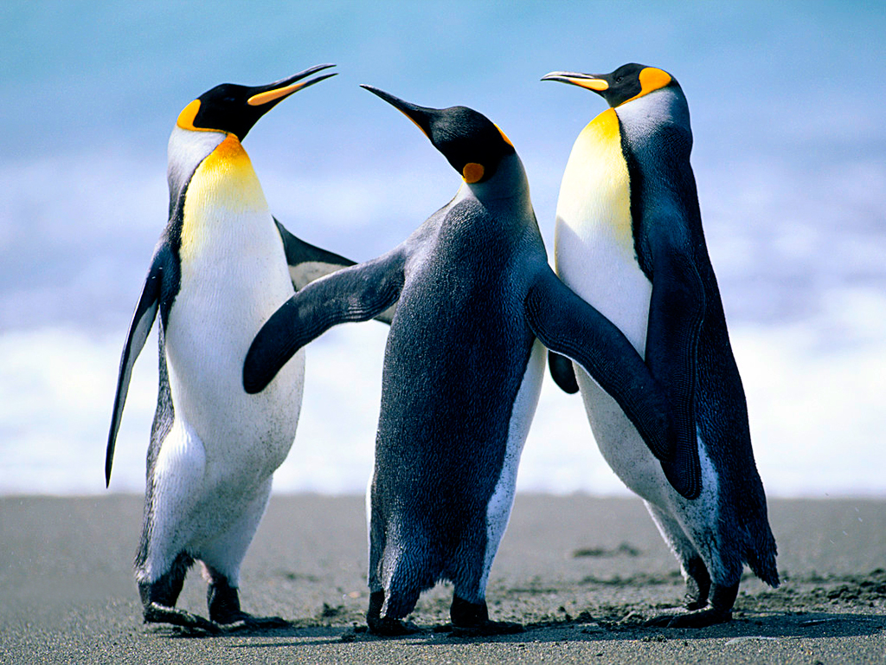
Why Critical Thinking Skills are needed??

